Slide 1
Supply and Demand gap analyses

Slide 2
AIM
The aim of the project is to analyze the dataset file and visualize the dataset according to the data given in the dataset.

Slide 3
INTRODUCTION
In the uber dataset, we can get some data regarding pickup and drop.
From this, we can analyze it according to year-wise the data.

Slide 4
PROBLEM STATEMENT
From the dataset, we can find how many requests id is placed from the city and airport. And we can find the status of the pickup and drop. And we can find how many trips are cancelled.

Slide 5
METHODOLOGY
In Uber, the Request Data set the first column is Request id in this column the request-id is present the placed by the customer.
In the second column, the pickup point is present in this data only two Airport and City pickup point is present.
The next column is Driver Id in this column so many drivers are present each driver assigns a separate driver ID.
Another column is Status in this Status column three statuses are present completed, cancelled and No car available.

Slide 6
METHODOLOGY
The first step is cleaning the data. In data cleaning I cleaned the data with the transform data option present in Power BI because the dataset was not cleaned and included some missing values, so with the help of the duplicates function in Power BI, I cleaned the data and replace the null values with 0 and then started working on it.
After Data cleaning performs the Data interpretation step. In Data interpretation found some important information.

Slide 7
VISUALIZATION
In visualization, I took the help of Power BI Desktop software to make graphs and charts here some relevant graphs and charts are attached.

Slide 8
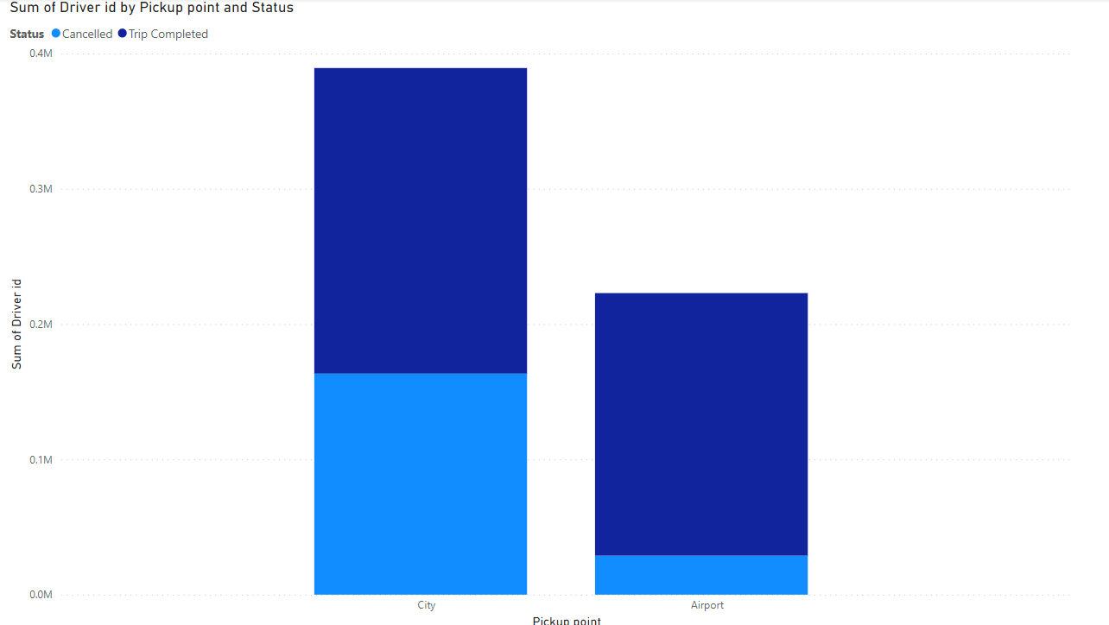
BAR GRAPH USING DRIVER ID BY PICKUP AND STATUS

Slide 9
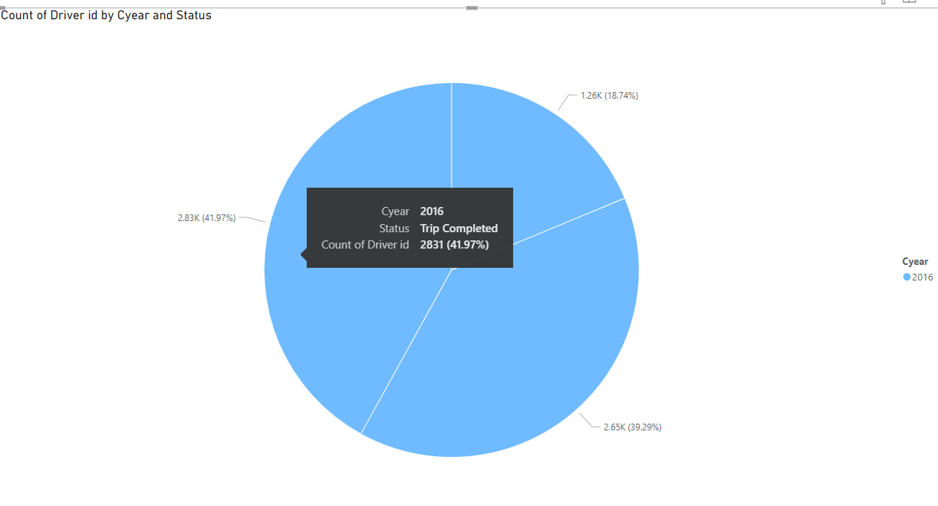
BAR CHART OF DRIVER ID

Slide 10
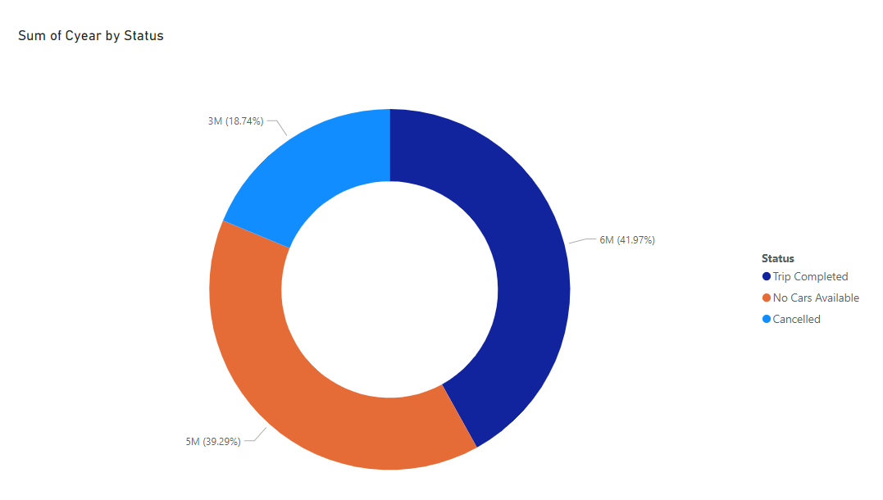
DONUT CHART USING YEAR BY STATUS

Slide 11
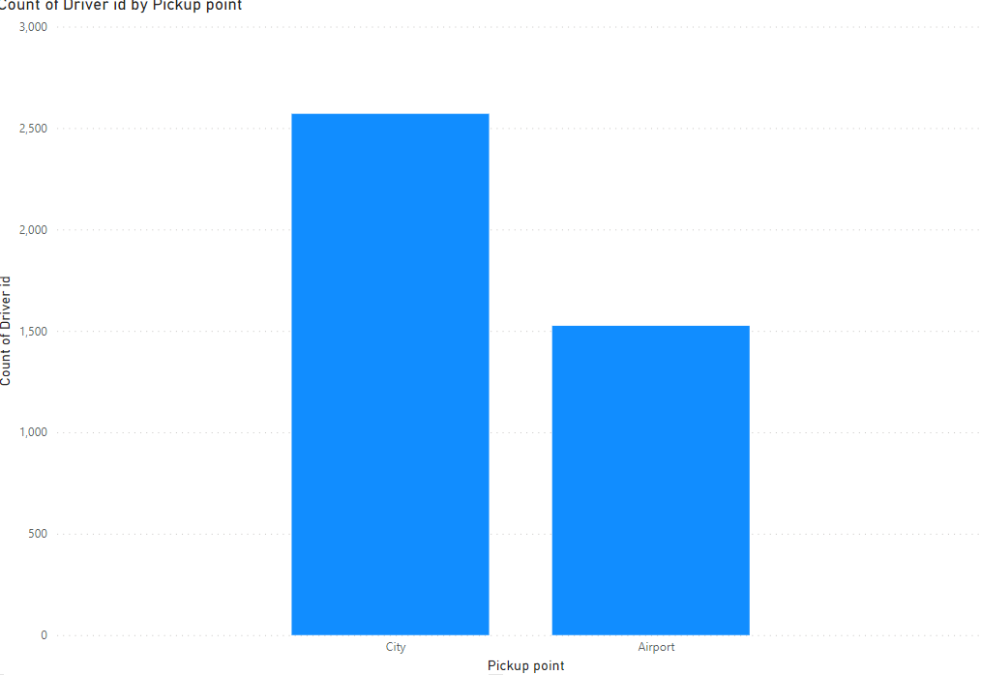
BAR CHART USING COUNT OF DRIVER ID BY PICKUP POINT

Slide 12
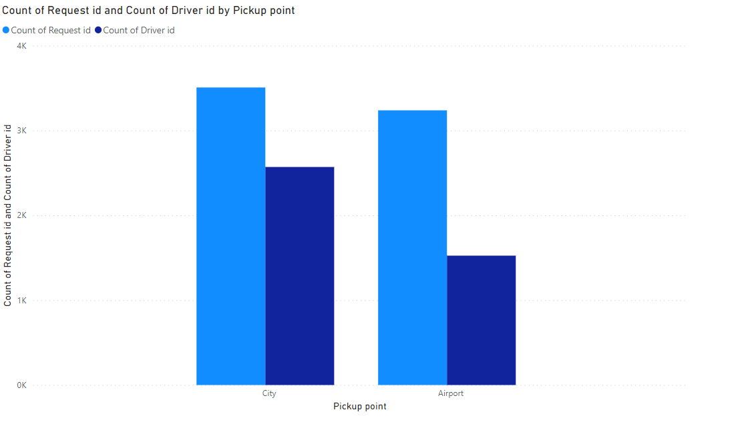
BAR CHART USING COOUNT OF REQUEST ID AND DRIVER ID BY PICKUP POINT

Slide 13
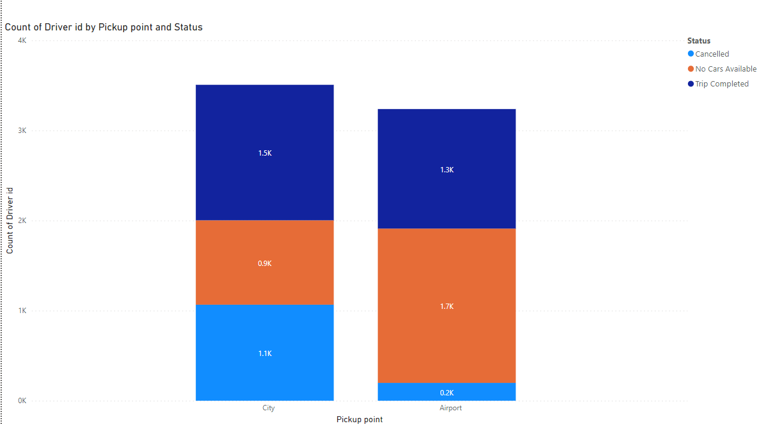
COUNT OF DRIVER ID BY PICKUP POINT AND STATUS

Slide 14
ANALYSIS
From the above analysis, we can know that
In the first chart, we may know that trip is complete, and the trip was cancelled in both city and the airport.
In the 2nd chart, In 2016, trips completed overall 69% and trips cancelled is nearly 30%
In the 3rd chart, year by status is shown, that’s the trip completed, no car available and cancelled are shown clearly.
In the 4th chart, the driver id and pickup point are taken. Therefore, the count of driver id in city is high compare to airport

Slide 15
INSIGHT
Here we have analysed the UBER dataset with some visualization.
And here some knowledge we get is, increase more cars in city and airport.
Mainly focus on increasing cars in airport.

Slide 16
RECOMMENDATION
We can analyze the data of the overall Trips in the City.
Like this dataset, we can Analyze the Data according to the Different Cities-Area it takes more clarity to how to fill the supply and demand gap.

Slide 17
CONCLUSION
From the analysis, we know that need to increase more number of cars in city and the airport.
Cancel should be avoid for better profit.

